Slide 1

Connected Operations (COps) Platform
Team 32: Jonathan Balliet, Caleb Boswell, Daniel Mills, Jeen Shaji, Spencer Yoder
Notes:
Phrases:
Project Recap
Requirements/constraints (demo)
Design
Low-Level discussion:
- Should be very SELinux-focused
Conclusion
Summary of Session with Ms. Heil:
We should go with this design for the presentation
Our presentation should be broken up to the sections (phrases) defined above
We should include some of the slides in the OPR 4 draft:
The slide detailing how users interact with use cases in CourseManager
Something similar to our testing progress (probably broken up over multiple slides)
Something similar to the SELinux Policy module code slide
At a high level, we should do the recap, go over requirements/constraints (for the current iteration), take a deep dive into our current progress, go over testing, and then conclude the presentation
For the deep dive, we should talk primarily about how we’ve integrated with SELinux, this will include how we’ve developed the policy and also how we’ve modified CourseManager/container runtime to interact with this policy. This will also be where our challenges will go.
We should be current-system-focused. E.g.
We no longer have the requirement to read in data from multiple stores
We’ve added the front-end as a requirement
etc.
I took some notes from the presentation and put them in the other slides

Slide 2
Content
Project Recap
Refining Requirements
CourseManager
Requirements, Design, Testing
Data Storage and Security
Requirements, Design, Testing
Container Runtime
Requirements, Design, Testing
End-to-end System Demo
Conclusion

Slide 3
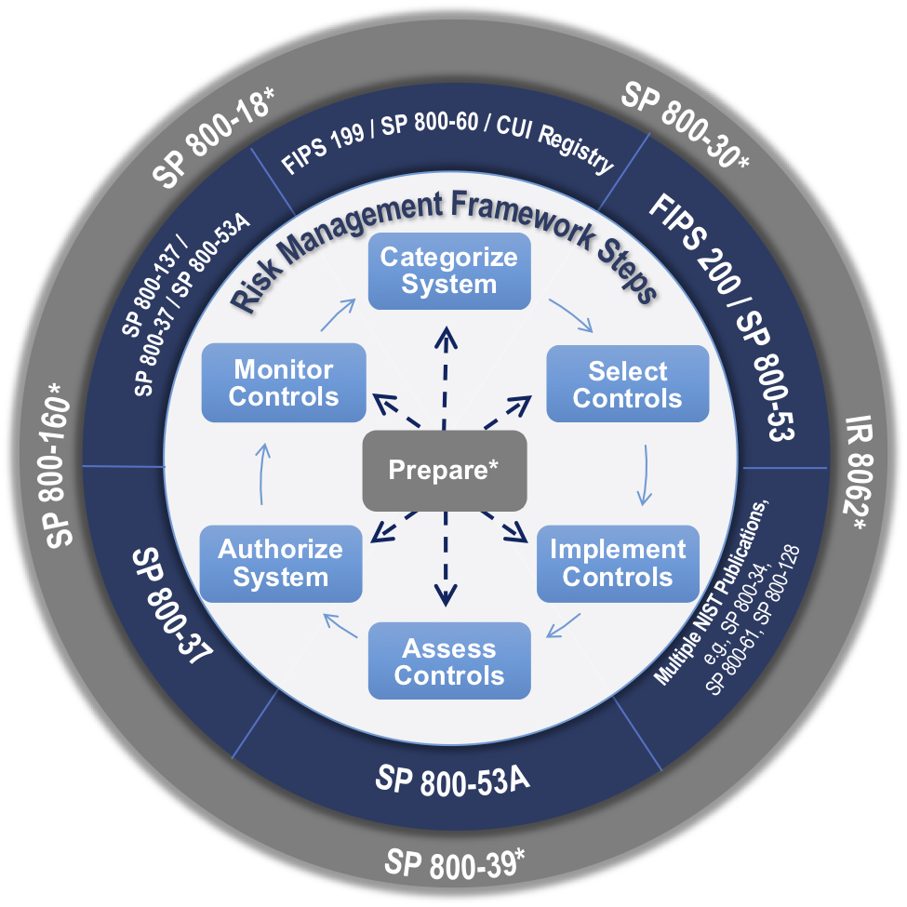
Project Recap Problem Statement
Paraphrased from the senior design website:
“How do we create a system which securely controls access to data with multiple security classifications in a single database?”
Top Secret
Secret

Slide 4


Project Recap Proposed Project
“The goal of the project is to have a Multi-Level Security(MLS) API gateway that allows the user to see what they have been cleared to see. The first phase for this semester is to utilize Docker containers and SE Linux labels in a Postgres database.”
API
Visible data
Hidden data

Slide 5

Project Recap Proposed Project
“Students will run an application within a docker container that is configured to use Multi Category Security and show that the application is restricted from accessing certain data within the database.”
API
Application
Visible data
Hidden data

Slide 6

Project Recap Proposed Project
“Students will have to consider ways to encrypt data at rest and ways to implement identity access management.”
API
IAM
Application
Visible data
Hidden data

Slide 7
Project Recap Proposed Project
DB1
DB2
DB3
“Students will automate a process to pull data from three different sources, label the data, and write it to the database. The data will need to be encrypted based on its label.”
API
IAM
Application
Data 1
Data 2
User 1
Data 3

Slide 8
Project Recap Proposed Project
DB1
DB2
DB3
“The meat of the application is creating an engine that stands up a docker container that can handle data classified to a certain level.”
API
Container 1
IAM
Application
Data 1
Data 2
User 1
Data 3

Slide 9
Project Recap Proposed Project
DB1
DB2
DB3
“That container needs to be dynamically spun up and pull data that only it has the read/write rights to see.”
Container 1
Application
API
Container 2
IAM
Data 1
Application
Data 2
Container 3
User 1
Data 3
Application

Slide 10
Project Recap Proposed Project
DB1
DB2
DB3
“The application within the container will need to have an API endpoint so that a web application get the data back to the user that the user has the right to see.”
App
API
Container 1
Application
IAM
Container 2
Data 1
Application
Data 2
User 1
Web Application
Container 3
Data 3
Application

Slide 11
Project Recap Proposed Project
DB1
DB2
DB3
“Web applications should then be able to send a request to the "super" system's API and return back the data encrypted to the user.”
Web Application
Container 1
Application
App
API
IAM
Container 2
User 1
Data 1
Application
Super system API
Data 2
Container 3
Data 3
Application

Slide 12
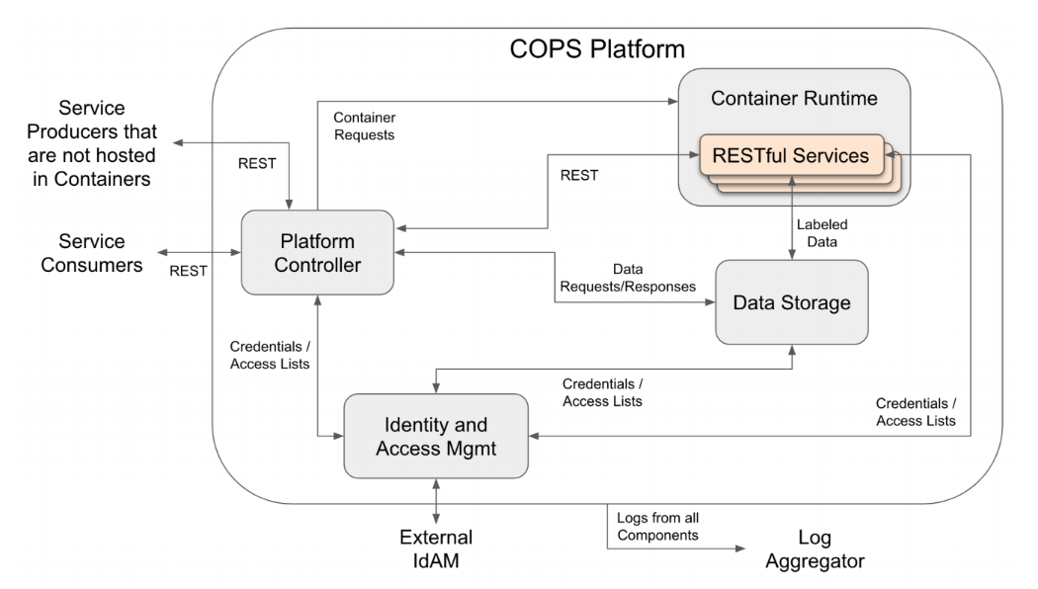
Refining Requirements Simplifying Project Scope
Components
Container Runtime
Data Storage
Platform Controller
IdAM
Log aggregator
Final Project Scope
Original Project Scope

Slide 13
Refining Requirements Resolving Ambiguity
Initial Project Plan:
Arbitrary services are used to access data
The data stored in the database is arbitrarily defined
Access rights are ambiguously divided
Revised Plan:
A single service, CourseManager, communicates with the database
Data matches CourseManager models and is automatically generated
Access rights are divided based on CourseManager user types

Slide 14
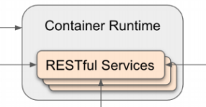
Refining Requirements CourseManager
A RESTful service and our primary tool in refining requirements
CourseManager provided us with:
A set of data objects around which to design our database
A set of access rights around which to design our security policy
A set of functionalities which could be tested to ensure a working system
students
account info
instructors
course data
CourseManager
coordinators
grades

Slide 15










Final High-Level Design
Service Request
User
CourseManager
RESTful service
SQL Query
REST Request
Spencer Yoder
JSON response
Caleb Boswell, Jeen Shaji,
Jonathan Balliet
Data
Daniel Mills
Jonathan Balliet
Daniel Mills, Spencer Yoder

Slide 16


CourseManager Overview
CourseManager is:
A Flask RESTful service.
A simple system for course scheduling and grading for university
Created in order to
Solidify our requirements and design
Test our end-to-end system
Coordinators
Students
Instructors
Grades
Courses

Slide 17
CourseManager
Requirements
3 Users, 6 Use Cases
 | UC 1 | UC 2 | UC 3 | UC 4 | UC 5 | UC 6
 | Login | View Account | Edit Course | Edit User | Edit Grade | View Schedule
Coordinator
Instructor
Student

Slide 18
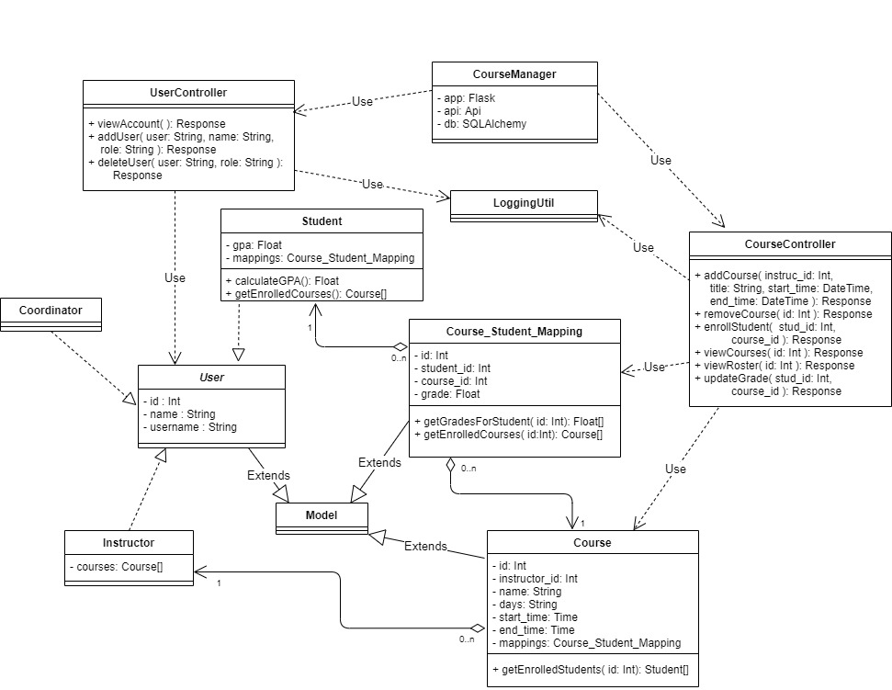
CourseManager
Design

Slide 19
CourseManager Testing
CourseManager’s models and controllers were tested using Python’s unittest framework.
Testing was fully completed with a coverage of before integration with the rest of the system.
Coverage (using coverage.py):
94%

Slide 20
Data Storage and Security Overview
Security
MAC implemented via type enforcement by SELinux
Data Storage
Implemented using Postgres
Data is labeled and protected by SELinux through SEPostgres
database
label
Subject
Object
table
label
column
label

Slide 21
Data Storage and Security Requirements
Our primary goal for the database was to cover the following cases to test the scope of the utility of SEPostgres
Uniformly accessible tables
Columns with different accessibility than their parent table
Relationships between these different kinds of tables
And to do it as simply as possible
0..n
0..n

Slide 22
Data Storage and Security SELinux Policy Design
3 types for users
coordinator_t
instructor_t
student_t
5 data types corresponding to various classifications of data
coordinator_t can read/write all these data types
coordinator_data_t
instructor_data_t: readable by instructor_t
student_data_t: readable by student_t
grade_data_t: readable by student_t and instructor_t, writable by instructor_t
course_data_t: readable by student_t and instructor_t

Slide 23
Data Storage and Security SELinux Policy Design
Readability diagram
coordinator_t
coordinator_data_t
instructor_t
student_t
course_data_t
grade_data_t
instructor_data_t
student_data_t

Slide 24
Data Storage and Security SELinux Policy Design
Writability diagram
coordinator_t
instructor_t
coordinator_data_t
instructor_data_t
student_data_t
course_data_t
grade_data_t

Slide 25
Data Storage and Security Database Labels
student student_data_t
instructor instructor_data_t
coordinator coordinator_data_t
id course_data_t
username course_data_t
name course_data_t
id course_data_t
username instructor_data_t
name course_data_t
id coordinator_data_t
username coordinator_data_t
name coordinator_data_t
course course_data_t
course_student_mapping course_data_t
id course_data_t
instructor_id course_data_t
name course_data_t
days course_data_t
start_time course_data_t
end_time course_data_t
id course_data_t
student_id course_data_t
course_id course_data_t
grade grade_data_t

Slide 26
Data Storage and Security Testing
Testing is integral to the development of an SELinux security policy, so it was done continuously throughout development.
However, after creation of the full policy, testing was formalized and automated via bash scripts

Slide 27
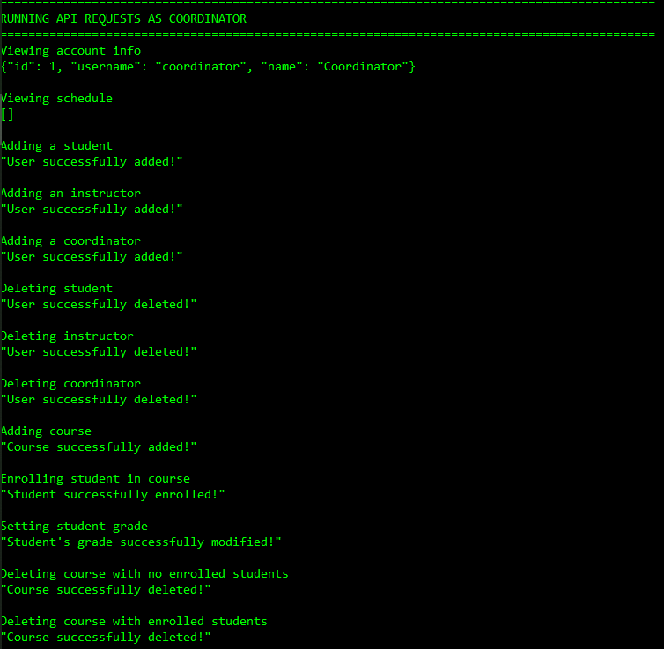
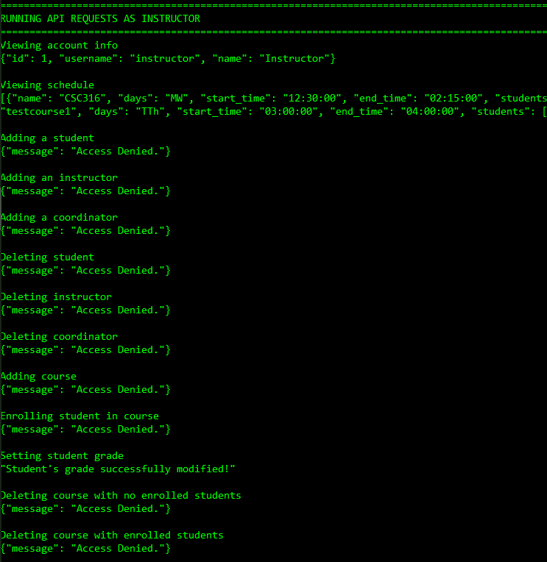
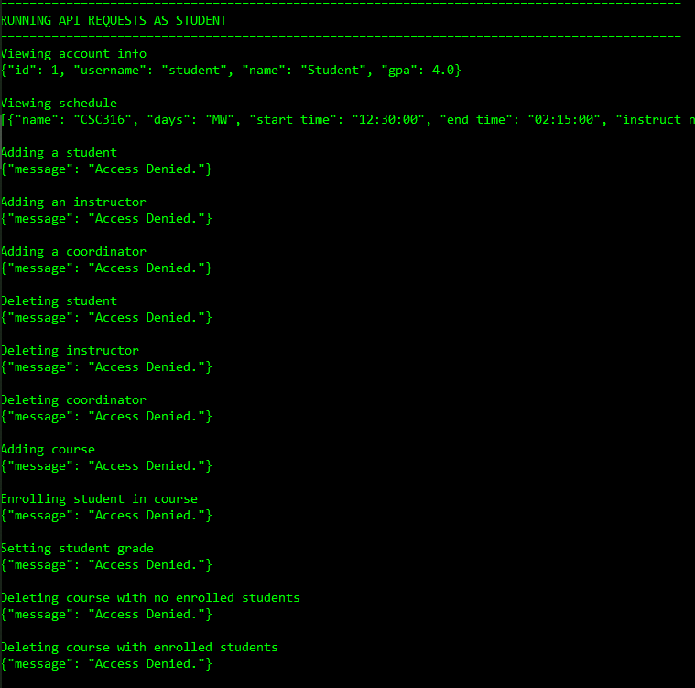
Data Storage and Security Testing

Slide 28
Container Runtime - Overview
Container Runtime is:
A Flask RESTful service.
Handles creating isolated running instances of a service via Docker Containers
Enforces security for the service based on the authorization levels of the user
Adjustments made from Problem Statement:
In order to create a full end-to-end system, some of the responsibilities of other COPs components were mocked within the Container Runtime
This includes:
Authentication
Authorization
Routing

Slide 29
Container Runtime - Requirements Overview
Containers shall provide isolated computing resources for RESTful services.
Shall run each container with the enforced security context of the user.
The service running inside the container must gracefully handle ‘Access
Denied’ errors when attempting to retrieve data from the Data Storage.
Shuts down a container when the user disconnects from the service.

Slide 30
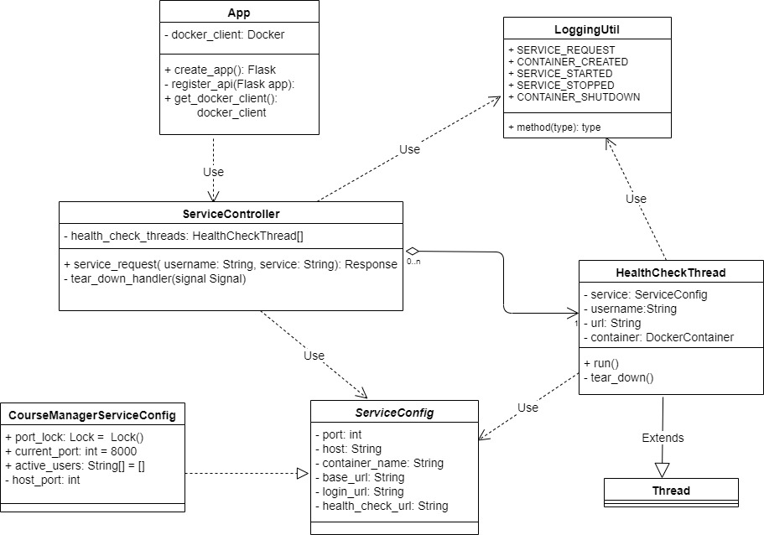
Container Runtime - Design
JB
Notes:
App - runs and initializes Container Runtime application. Docker_client - we use this to communicate with the Docker Service
Service Controller - POST request endpoint to handle service request from the user. Passes in username and service name. Creates container with the authorization levels of the user
Service Config - Abstract class containing all the fields a service needs to work with our application. The Course Manager Service Config class is an concrete implementation for our Course Manager Service
HealthCheckThread - We can easily create multiple running containers via our Docker client.. but how do we monitor all of the containers? Use a thread to check a special endpoint on the service running in a container every 30 seconds.
When the user’s session ends - we know we can then shut down this container.
LoggingUtil - Logs all the transactions that occur in the Container Runtime

Slide 31
Container Runtime
Handles service requests
The service name and credentials of user sent in POST request
Authenticates user and determines authorization level
In the real COPs system, the IAM handles this
User
Container Runtime
Postgres Server
Service Request
Authenticate User
Authorization Level

Slide 32
Container Runtime
Creates a Docker container to run service for the user
Course Manager is the only service supported currently
Labels the IP connection of the Docker Container to ensure security
Using 3 roles for our authorization levels (‘coordinator’, ‘instructor’, or ‘student’)
Container 1
CourseManager
IP 1
label
Postgres Server
Postgres IP
Container 2
CourseManager
IP 2
label

Slide 33
Container Runtime
Forwards route to running service in the response
In the real COPs system, the Platform Controller handles all routing
Container
Service Request
User
CourseManager
RESTful service
Service Response
URL for CourseManager

Slide 34
Container Runtime
Monitors the lifecycle of all containers
Creates a “Health Check” thread for each running container
If the user is inactive or disconnects from service, shuts down the container
User 1
REST Request
Container 1
CourseManager
Health Check
Thread
JSON Response
User 2
REST Request
Container 2
CourseManager
Health Check
Thread
JSON Response

Slide 35
Container Runtime - Testing
Container Runtime was tested using Python unittest framework.
Tests to ensure that containers properly run the Course Manager service, handle exceptions, and shut down after a user disconnects.
Challenges:
Testing issues due to multithreading and signals needed for containers and thread clean up.
Coverage is not entirely accurate because code within threads is ignored.
Coverage (using coverage.py):
80%

Slide 36
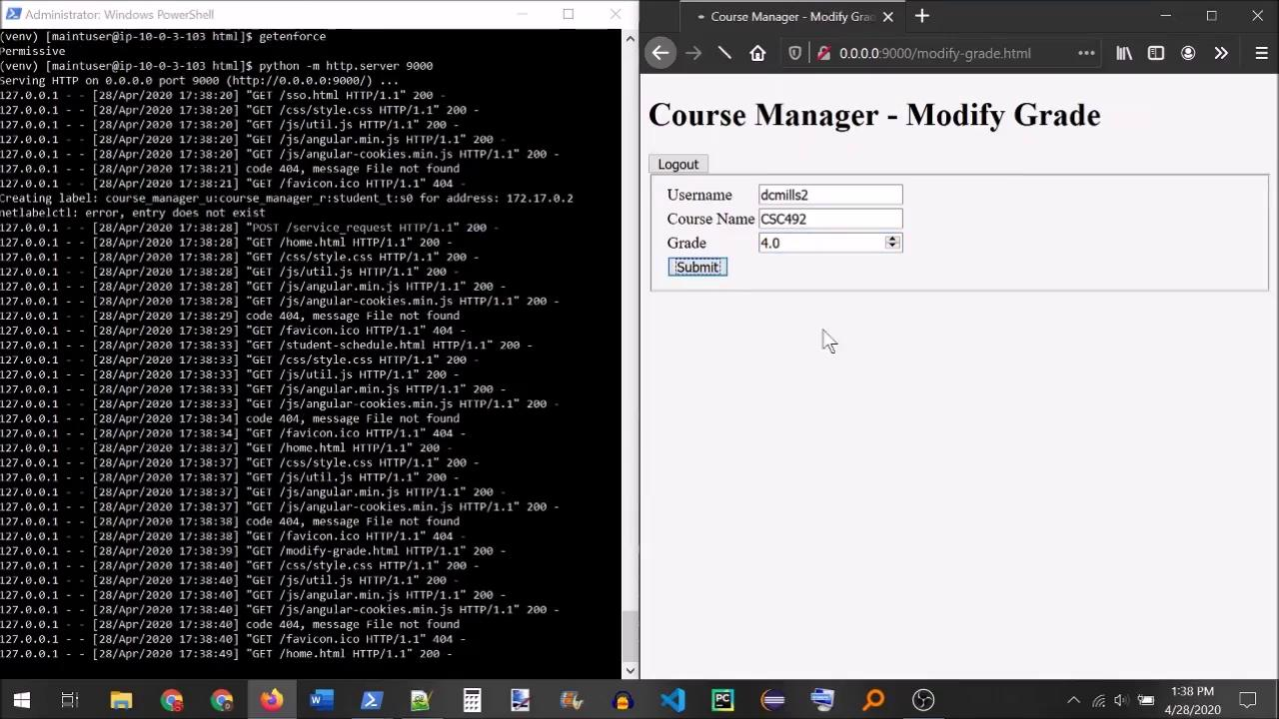
End-to-end System Demo
Notes:
Creating SSH tunnel
SELinux is enforcing
Running flask app in background
Changing to HTML location
Running HTTP server python module
Connect on browser
Log in as coordinator
Coordinator has all permissions
Acc details
Add Daniel as student
Add Ms. Heil as instructor
Add CSC492, Ms. Heil as instructor
Enroll Daniel in CSC492
Modify grade
Logout
Container shuts down
Log in as Ms. Heil
Acc details
Schedule
Show students
Modify grade
Try to delete CSC492
Try to delete Daniel
Log out
Log in as Daniel
Schedule
Try to modify grade
Try to delete CSC492
Try to delete Ms. Heil
Schedule (nothing changed)
Log out
Turn off SELinux
Log in as Daniel
Schedule (grade still 3.5)
Modify grade
Schedule (grade changed)
Remove CSC492
Schedule (empty)
Remove Ms. Heil
Log out
try to log in as Ms. Heil

Slide 37
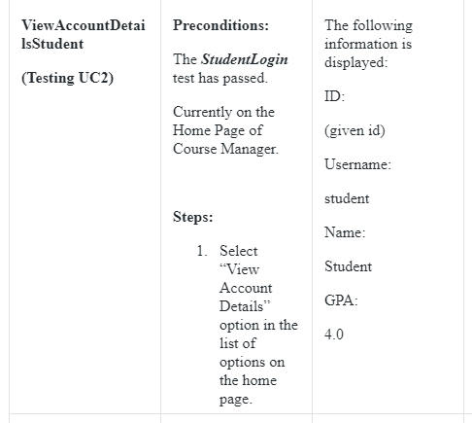
Blackbox Testing
Front-end manual tests to ensure system is working end-to-end as expected and is secure
Users attempting to do actions outside their security privileges results in “Access Denied” response

Slide 38
Conclusion Advice for Future Teams
Read our documentation
SELinux and its interactions are sparsely documented on the internet
Prioritize the bare essentials
When working with new tools, learning them takes a lot of time
Prioritize a small set of deliverables before tackling secondary implementation

Slide 39
Conclusion Where to go from here
What we scrapped from the original description to deal with scope
Encryption based on security label
A formal Identity and Access Management system
A formal Container Orchestration system
A formal logging system (aside from logs created by our technologies)
A way to consolidate data from existing databases

Slide 40
Conclusion Where to go from here
Flaws with our current implementation
SEPostgres is SELinux-aware. Access is (potentially) denied in userspace
Docker containers are unlabeled, only their IP addresses are labeled
We use regular type enforcement (not MLS/MCS) to enforce our policy
Certain configurations must be done manually for each system launch

Slide 41
Questions?

Slide 42
Thank you!
For helping us throughout senior design and allowing us to demonstrate what we’ve learned.

